Slide 1
Gene Structure and Function
Current estimates of the human genome ~20,000 protein-coding genes … seems insufficient.
Two features of gene structure and function that suffices for executing the large array of functions needed by cells:
Many genes are capable of generating multiple different products.
Individual proteins do not function by themselves. They form elaborate networks, thus, different combinations results in greater diversity of cellular functions.

Slide 2
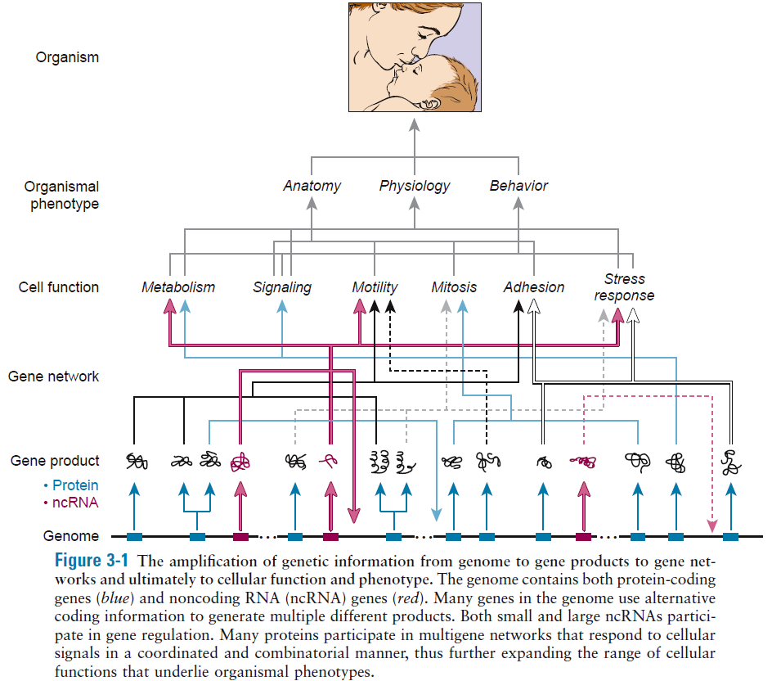

Slide 3
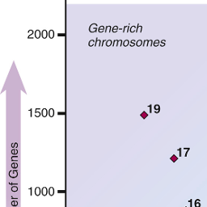
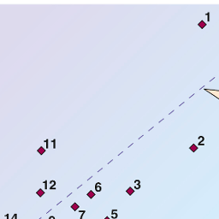
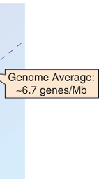
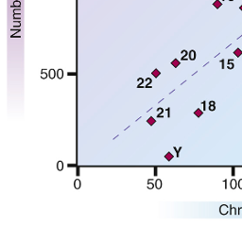
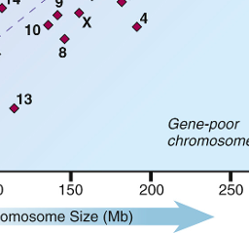
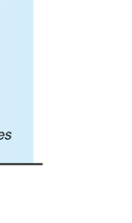
Some chromosome regions, or even whole chromosomes, are high in gene content (“gene rich”), whereas others are low (“gene poor”).
Abnormalities of gene-rich chromosomes or chromosomal regions tend to be much more severe clinically than similar-sized defects involving gene-poor parts of the genome.
Figure 2-7 Size and gene content of the 24 human chromosomes. Dotted diagonal line corresponds to the average density of genes in the genome, approximately 6.7 protein-coding genes per megabase (Mb). Chromosomes that are relatively gene rich are above the diagonal and trend to the upper left. Chromosomes that are relatively gene poor are below the diagonal and trend to the lower right.

Slide 4
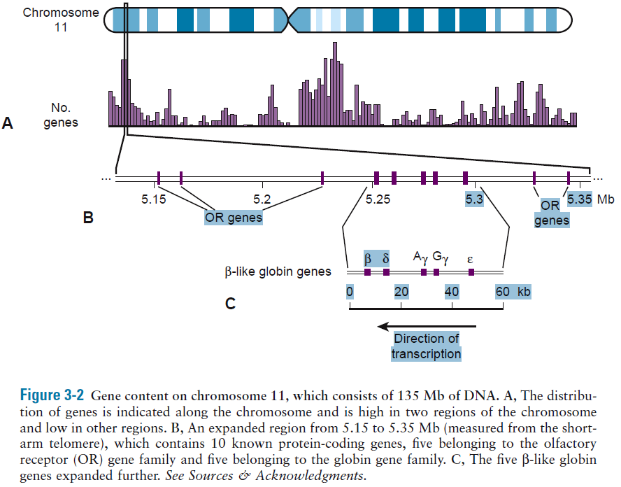

Slide 5
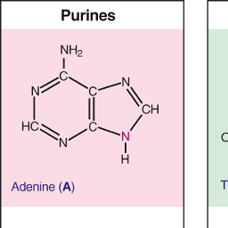
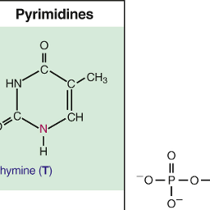
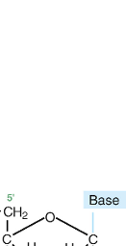
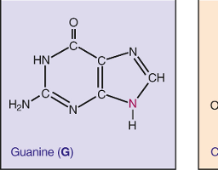
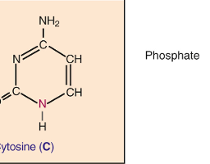
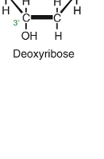
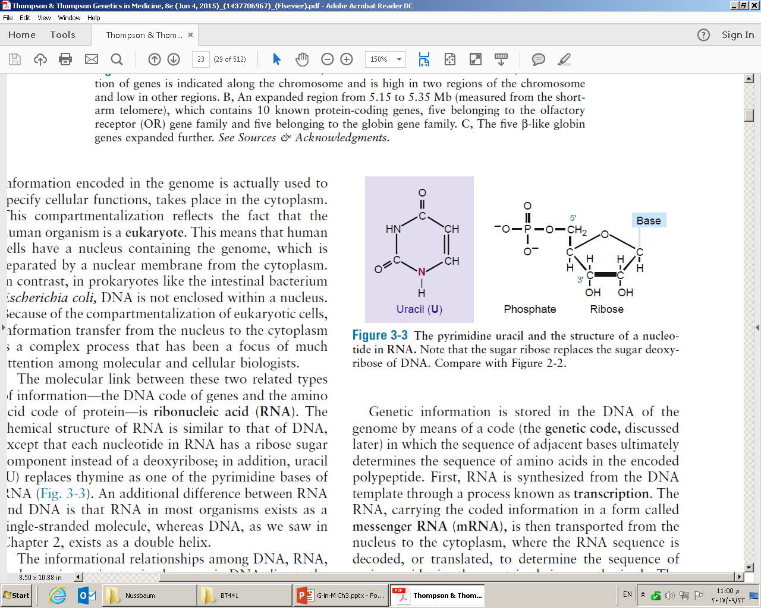
The Central Dogma of Molecular Biology
DNA>RNA>Protein

Slide 6
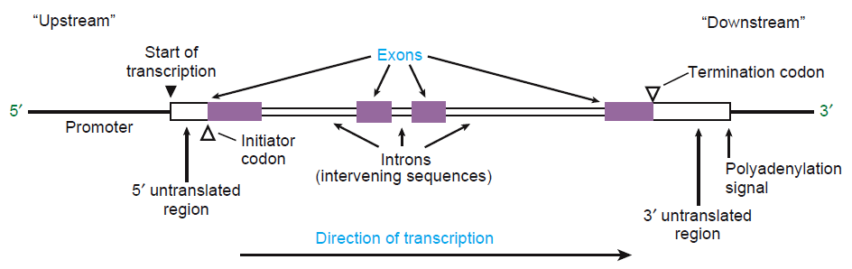
General structure of a typical human gene

Slide 7
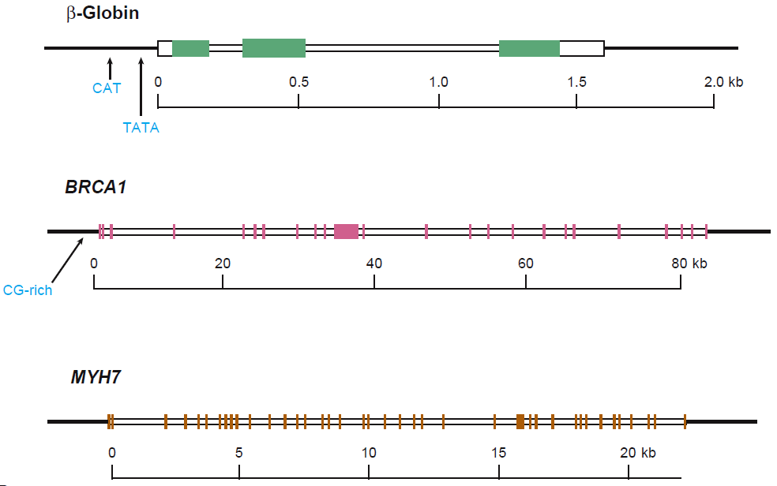
3 exons > disorders of hemoglobin
24 exons > inherited breast or breast and ovarian cancer
40 exons > inherited hypertrophic cardiomyopathy

Slide 8
Pseudogenes
DNA sequences that closely resemble known genes but are nonfunctional
Nonprocessed pseudogenes: were once functional but are now vestigial, inactivated by mutations in critical coding or regulatory sequences
Processed pseudogenes: formed by retrotransposition:
transcription
generation of DNA copy of mRNA (cDNA) by reverse transcription (reverse transcriptase enzyme)
integration into the genome at a different location

Slide 9
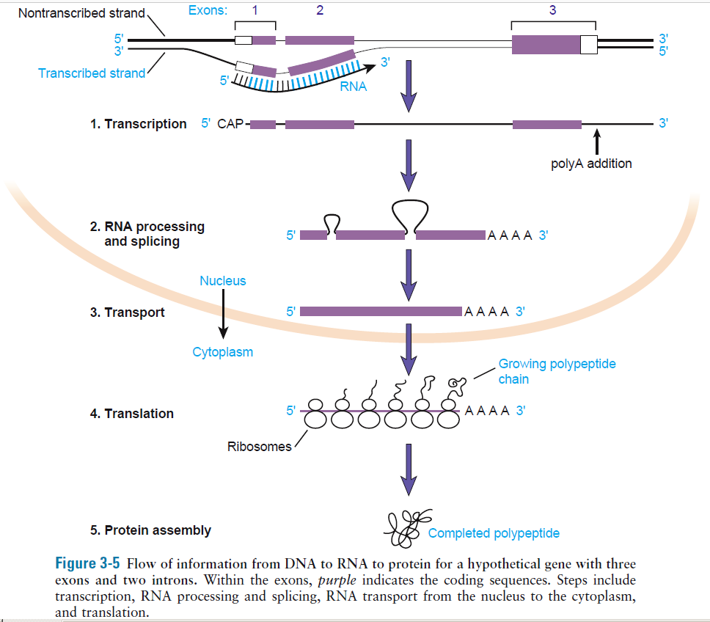

Slide 10
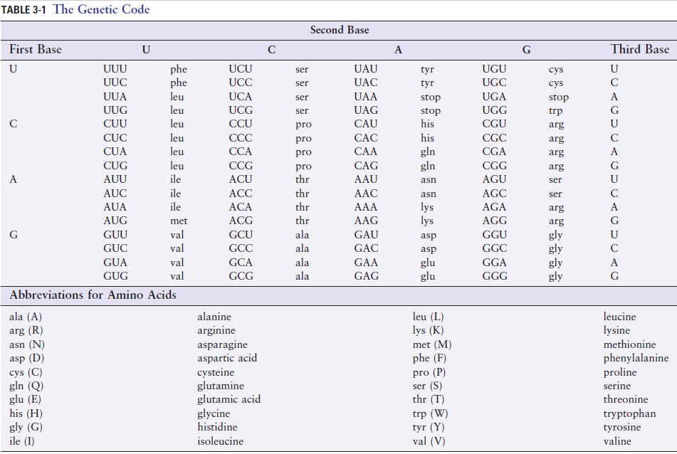
Code is degenerate

Slide 11
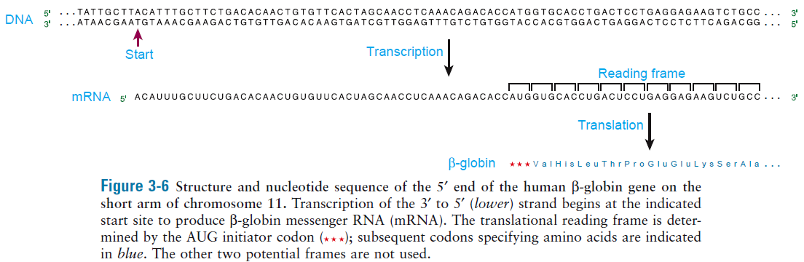

Slide 12
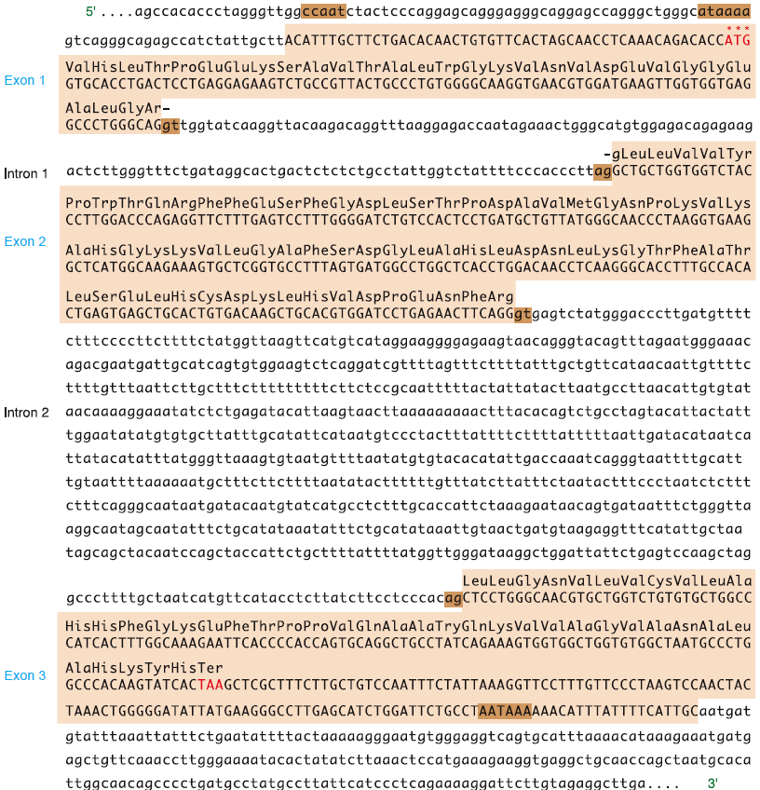

Slide 13
Not all genes in the genome can be actively expressed in every cell at all times
Specific characteristics of chromatin are associated with active or repressed genes
Epigenetics focus on reversible changes of chromatin landscape as determinants of gene function rather than on changes to the genome sequence itself

Slide 14
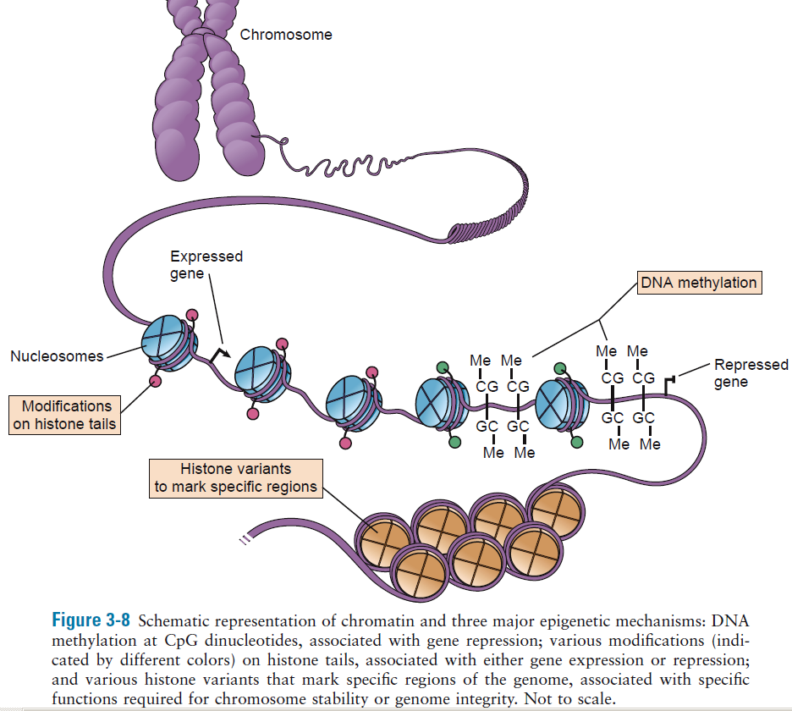
Epigenetic changes can be transient or long lasting

Slide 15
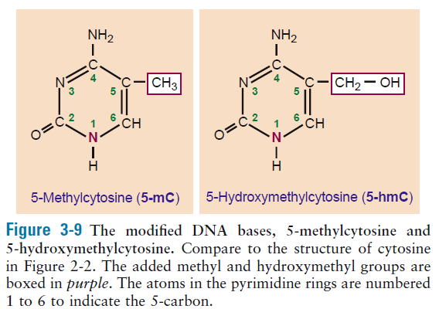
Extensive demethylation occurs during germ cell development and early stages of embryonic development to re-set chromatin environment
Reprogramming steps involve conversion of 5-mC to 5-hmC as an intermediate in the demethylation of DNA

Slide 16
Histone modifications include methylation, acetylation, and phosphorylation at the N-terminal tails of histones that extend out of the core nucleosome.
Histone variants are products of different genes and their amino acid sequences are distinct from those of canonical histones. CENP-A is a variant histone related to histone H3, found in cetromeres
Chromatin architecture, the genome adopts a highly ordered and dynamic arrangement within the space of nucleus

Slide 17
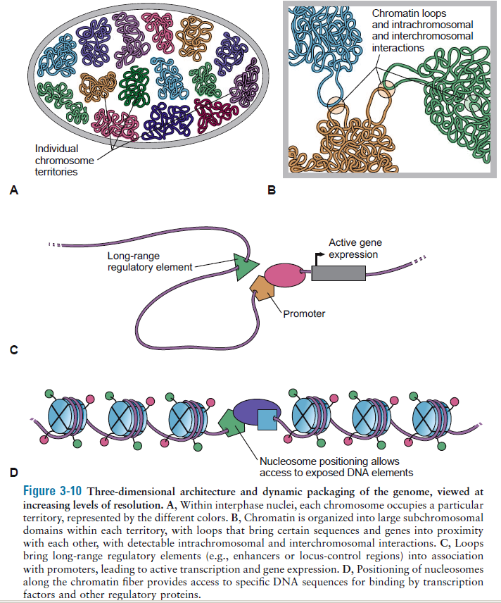

Slide 18
Topologically associating domains (TADs)
Chromosomes are organized in the 3D space of the nucleus to fulfill gene regulation
Chromosomes are spatially segregating in A- and B-type genomic compartments that represent active (euchromatin=open chromatin) and inactive (heterochromatin=repressive chromatin) domains, respectively

Slide 19
Genomic compartmentalization can comprise multiple subcompartments
Nucleolus forms at site of hundreds of ribosomal genes of acrocentric chromosomes for preassembly of ribosomal subunits
Splicing speckles are nuclear domains enriched for splicing machinery
Promyelocytic leukemia (PML) bodies are involved in cell cycle processes and DNA repair

Slide 20
Genomic compartments are subdivided into clusters of genomic interactions, termed topologically associating domains

Slide 21
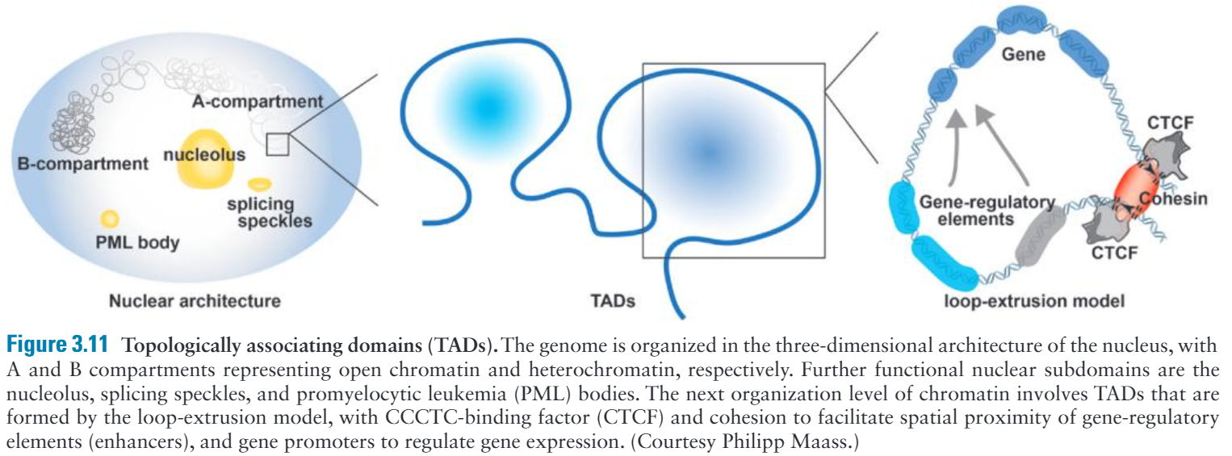
Reorganization of TAD architecture by chromosomal rearrangements can alter gene expression and may cause clinically apparent disease phenotypes
Genomic deletions can lead to TADs fusing
Duplications may form neo-TADs
Inversions reshuffle TADs
Translocations could alter interchromosomal contacts between nonhomologous chromosomes

Slide 22
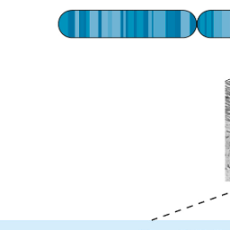
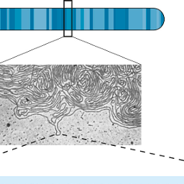

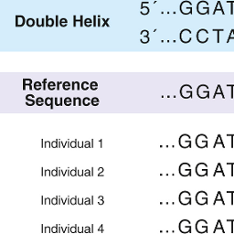
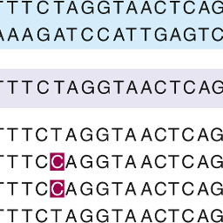
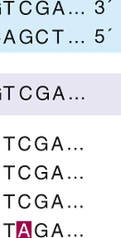



Sequence of DNA of a group of individuals is similar but not identical to the reference

Slide 23
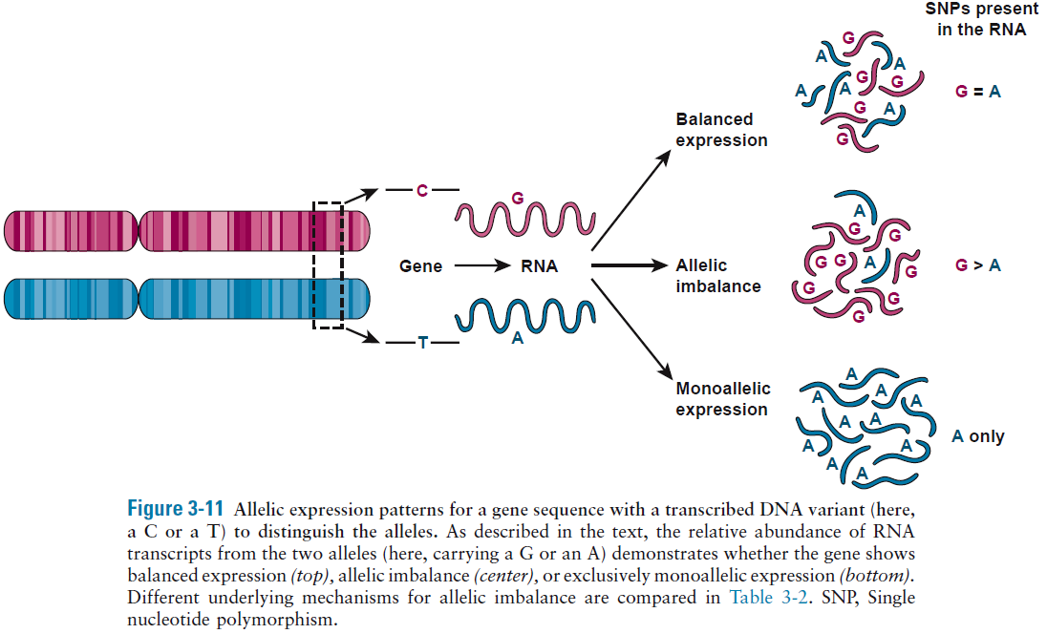
Allelic imbalance in gene expression
Most genes show equivalent levels of biallelic expression, however, 5-20% of autosomal genes show unequal allelic expression

Slide 24
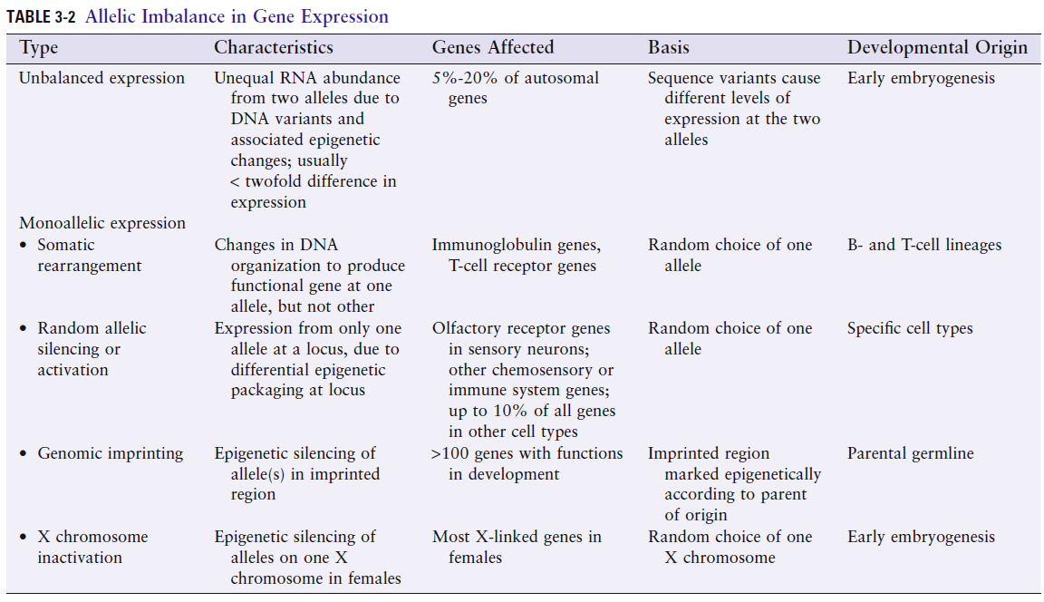

Slide 25
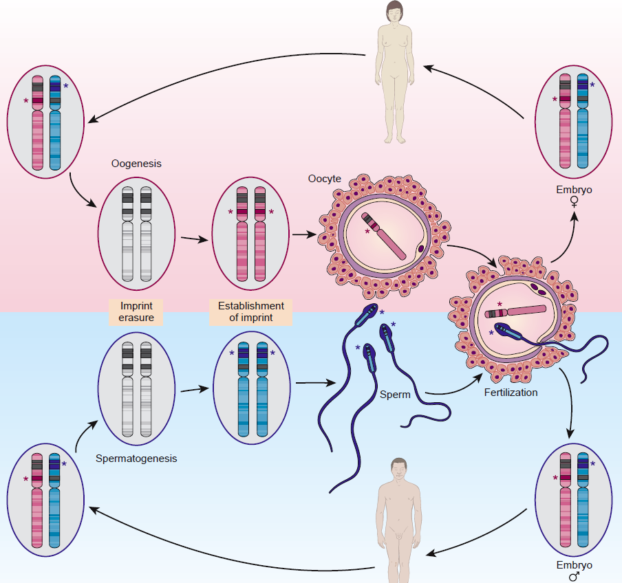
♀
Genomic imprinting and conversion of maternal and paternal imprints during passage
through male or female gametogenesis
♂

Slide 26
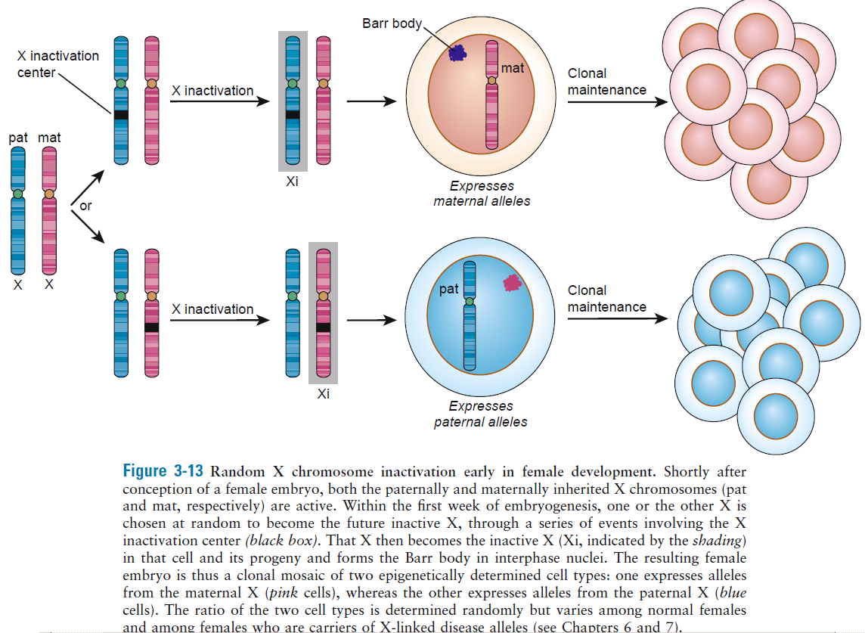
XIST: inactive X specific transcripts [ncRNA]

